Slide 1
Disaster recovery with ibm cloud virtual servers
Presented By,
R.Divya
E.Janani
R.R.Kanishka
P.Kavisri
P.Vinothini

Slide 2

About the disaster recovery with ibm cloud virtual servers
Disaster recovery is a crucial aspect of business continuity planning.
It involves the strategies, processes, and technologies a company puts in place to recover and resume normal operations after a disruptive event, such as natural disasters, hardware failures, data breaches, or other critical incidents.

Slide 3
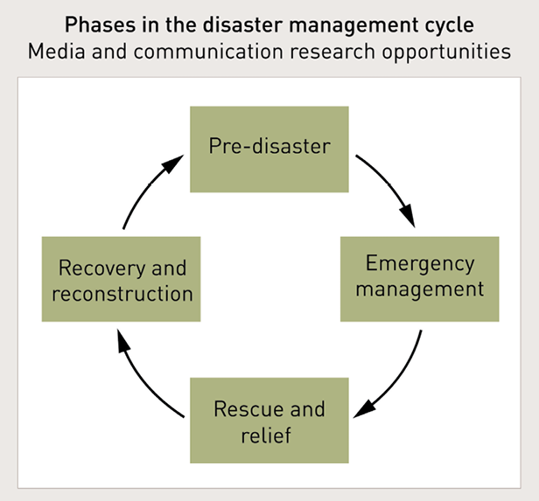
Stages to implement disaster recovery

Slide 4
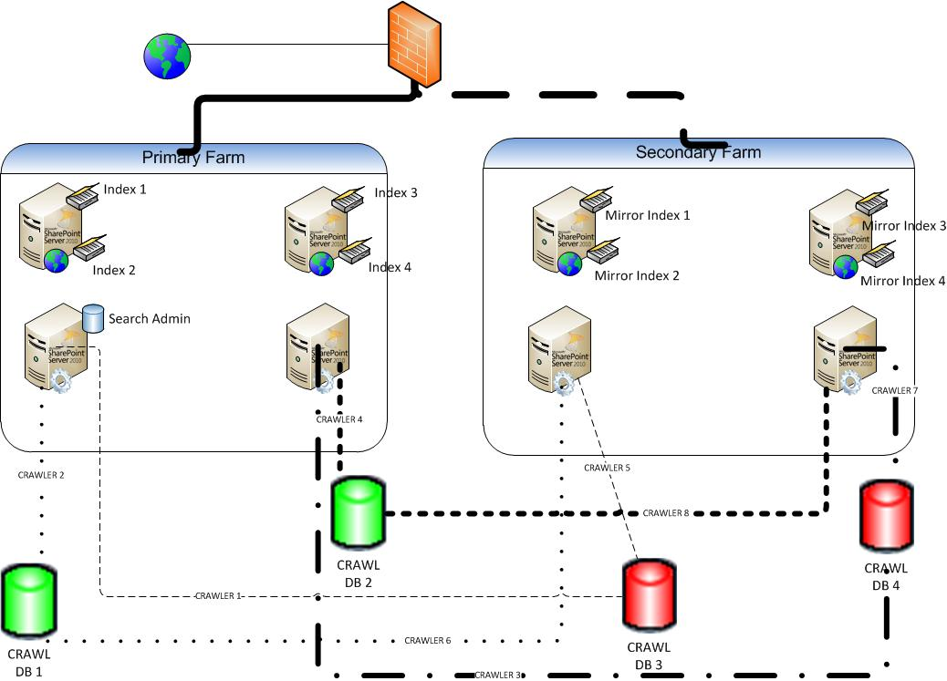
Architecture of disaster recovery
The architecture of Disaster Recovery (DR) with IBM Virtual Cloud Servers involves a well-structured setup to ensure data and application resilience.
Here's an overview of the architecture:
Primary and Secondary Data Centers
Data Replication
Failover Mechanisms
Security,Monitoring,and Testing

Slide 5
Procedure of disaster recovery
To implement disaster recovery with IBM Virtual Cloud Servers in a nutshell:
Assess and prioritize critical data and applications.
Set up data replication and failover mechanisms.
Regularly test and validate the recovery plan.
Maintain robust security measures and monitoring.
Continuously review, document, and adapt the plan to changing needs.

Slide 6

Conclusion
Disaster Recovery with IBM Virtual Cloud Servers is a vital strategy to maintain business continuity.
It involves data replication, failover mechanisms, and robust security measures to protect critical assets.
Rigorous testing ensures readiness, while ongoing maintenance and adherence to recovery objectives are essential for long-term effectiveness.

Slide 7


